Slide 1


Product Demand Prediction
Predicting product demand is crucial for any business. In this presentation, we'll cover the methods, factors, and benefits of demand prediction, as well as the challenges and best practices for successful prediction.
By
Rohith Vaasan A M
Rohithkumar K
Guruprasad R
Prasanna Balaji M
Sanjay M

Slide 2
Methods for Product Demand Prediction
1
Historical Data Analysis
Explore past sales data to identify trends and patterns, and use that information to predict future demand.
2
Market Research and Customer Surveys
Collect data on customers' needs and preferences, as well as market conditions, to better understand demand and make more accurate predictions.
3
Machine Learning and Predictive Modeling
Use advanced algorithms and techniques to analyze data and make predictions based on patterns and correlations.

Slide 3
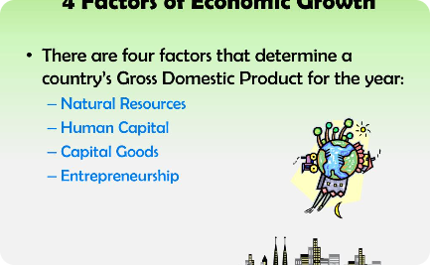
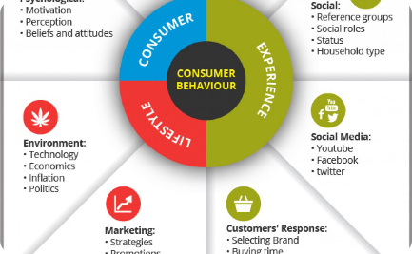
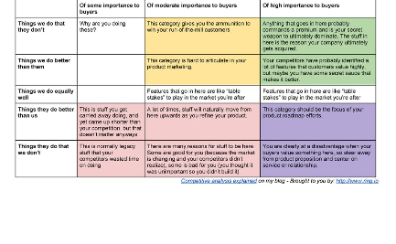
Factors Influencing Product Demand
Economic Factors
Consumer Behavior and Trends
Competitor Analysis
Changes in the economy, such as inflation or recession, can greatly impact consumer behavior and demand for certain products.
Understanding the actions and strategies of competitors in the market can help to predict shifts in demand and stay ahead of the competition.
Shifting consumer preferences and trends can significantly alter demand and sales patterns for a product.

Slide 4
Benefits of Accurate Demand Prediction
Optimized Inventory Management
Enhanced Production Planning
Customer Satisfaction and Retention
By predicting demand, businesses can manage their inventory more efficiently and prevent overstocking or stock shortages.
Accurate demand prediction can assist in production planning, ensuring that the right amount of products are produced at the right time.
Meeting customer demand and ensuring that products are in stock when customers need them leads to greater satisfaction and retention.

Slide 5

Challenges in Product Demand Prediction
Data Quality and Availability
Uncertainty and Volatility in Market Conditions
Accuracy and Reliability of Prediction Models

Slide 6
Best Practices for Successful Demand Prediction
Use of Multiple Prediction Methods
Continual Monitoring and Adjustment of Models
Collaboration Between Different Departments
Using multiple methods of predicting demand can improve accuracy and ensure that a variety of factors are considered.
Effective communication and collaboration between departments can ensure that all aspects of demand are considered and that all stakeholders are on the same page.
Staying on top of changes in demand and adjusting models accordingly is key to staying ahead of the curve.

Slide 7

Conclusion
1
Summary of Key Points
2
Importance of Demand Prediction for Business Success
Predicting product demand is crucial for optimizing business operations and meeting customer needs. Methods include historical data analysis, market research, and machine learning techniques, while challenges include data quality and model accuracy.
Accurate demand prediction can lead to optimized inventory management, enhanced production planning, and greater customer satisfaction, all of which contribute to overall business success.

